Slide 1
Overdose Death Rate Analysis (1999-2020)
Arianna De Jesus
HIT 216
05/08/2025

Slide 2
How do average overdose death rates compare across different racial and ethnic groups in the United States from 1999 to 2020?
This project focuses on disparities amongst various demographics to identify trends that could help implement public health strategies to improve these issues.

Slide 3
Overview
This dataset is from the CDC – ranging from 1999 to 2020
Tracks overdose death rates by:
Age
Year
Race/Ethnicity
Drug Type

Slide 4
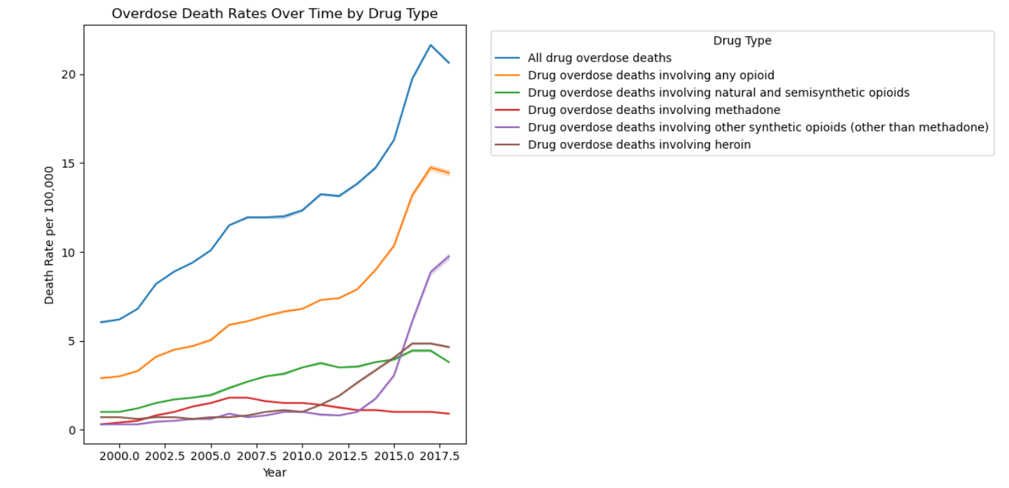

Trends Identified
Overdose death rates have increased steadily over time
There was a sharp rise after 2013
Most of the recent increase seems to be from synthetic opioids

Slide 5
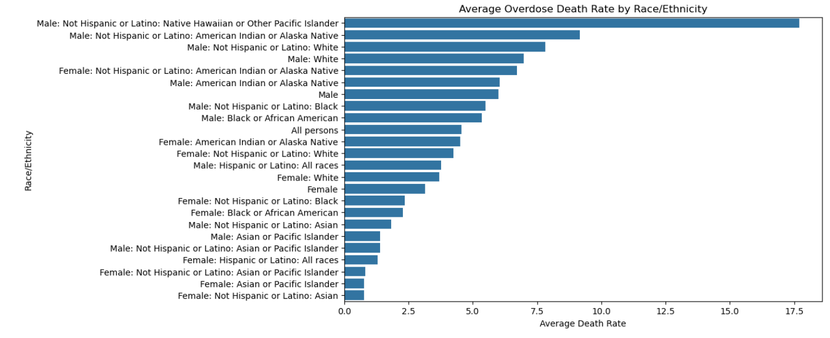
Racial/Ethnicities Disparities
Vast differences across races
Some of the populations are at higher risk
Public health strategies should focus on the most affected groups of people with personalized support, resources, and care that is culturally aware

Slide 6
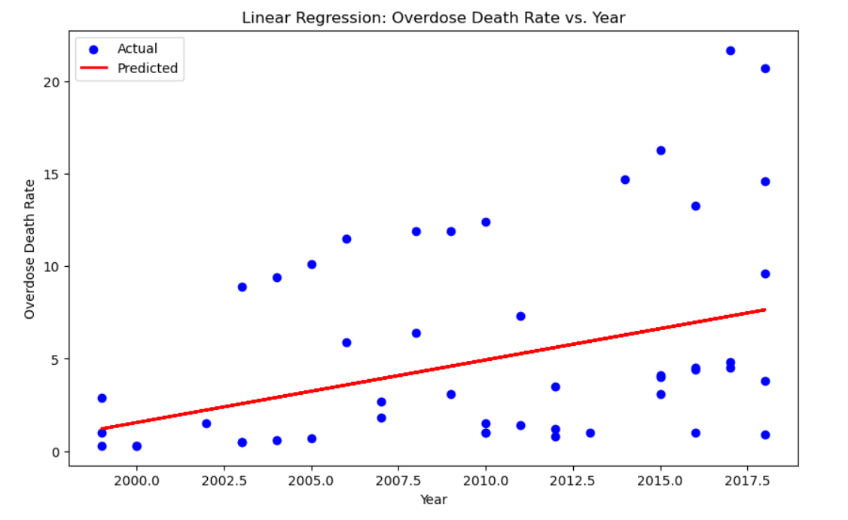
Predictive Modeling
Linear regression model shows death rates from year
There is an upward trend of these death rates

Slide 7
Conclusion
Overdose death rates continue to rise
These rates are unequal amongst different races/ethnicities
Solutions should be focused on at-risk populations, and the specific drug types being used

